Slide 1
SMHA Annual Coaches and Managers Meeting
(Virtual Zoom Meeting)
Oct 9th, 2024
Terry Foley – President SMHA
Notes:
1

Slide 2

SMHA Executive and Council
We Thank You.!!
All names and contact information can be found on the SMHA Website:
www.stittsvilleminorhockey.com

Slide 3
Stittsville Minor Hockey Association
Contents
Ottawa 67’s Minor Hockey Program – Brodie Gagnon Ottawa 67’s
Affiliations (AP’s)
Rosters
Travel Permits
Team Budgets
Gender Identity Training (GIT)
Risk and Safety
Appeals
Harassment of Officials
Head Coach Responsibilities
Equipment
Misc Items

Slide 4
Stittsville Minor Hockey Association
SMHA
Largest Membership in District 4.
TEAM’S
49 - House
  U7 – 10, U9 – 9, U11 – 8, U13 – 6, U15 – 7, U18 – 9
9 – Competitive
Total – 58 Teams.
SMHA Management Council
Consists of 32 Members.

Slide 5

Important SMHA Event Dates
Additional Information
Picture Day – October 26th & 27th @ Sacred Heart High School.
Important Association Events:
Ottawa Senators/Stittsville Minor Hockey Night – Details to come…..
IP / Novice Social – November 2nd @ 7pm @ the Barley Mow Stittsville.
RAMS Day – November 2nd @ JLA. Lots of Fun.!!!

Slide 6

SMHA & LCMHL Website
LCMHL / SMHA Website – Both new this season! Stay tuned after this call for an in-depth session with SMHA Webmaster Brad MacDonald.
New this year is our migration to the SportsHeadz platform.
Most material will be covered by LCMHL call.
DO NOT BUY TEAM SNAP THIS SEASON! The new SportsHeadz platform comes with a mobile app that has all the same functionality as Team Snap and is included for free to all of our teams.

Slide 7
Affiliations (AP’s)
Affiliations
SMHA follows the Club System for league play – Now scored in TTM.
Details are on our SMHA Website under FOR TEAMS tab, https://stittsvilleminorhockey.com/Pages/1170/Player_Affiliation_Guidelines/
Important that the Coach of the team the player is rostered on keeps track of the number of games a player affiliates.
Coach should never contact the player directly. Let coaches speak to other coaches.
Cannot be more then 15 games. No Limit for Goalies.
The 15 games are league and playoff games and do not include tournaments or exhibition games.
Teams that use an affiliated player without permission may face a 5-game suspension.
Please keep your convenors in the know.
Notes:
19 Player System
• Roster up to 19 players (incl. affiliates)
• Affiliates are exclusive to your team
• Affiliates must be rostered
• Affiliation up to a max of fifteen (15) games, excluding exhibition games
• No limit on Goalies
• A player’s coach is responsible for tracking the affiliations of his team members

Slide 8
Roster Information
Getting an Official Roster – Leanne Simpson (SMHA Registrar)
Template will be sent to each team from your Convenor at level.
All teams to provide their team rosters to their Convenors by Oct 15th at the latest. (Nothing Pending Please)
Please don’t wait until the last minute.
Signed official rosters will be returned to you in 7-10 days.
Maximum # of bench staff is 5, if you have any questions please ask your convenor.
Credentials for bench staff can be found here: (Refer to Level, Division, Position)
http://hockeyeasternontario.ca/pages/coach/coachcert.php
Ensure this is one of your first tasks on the team. If you have away tournaments requiring a travel permit, you will need your official roster back first. Please let your convenor know.
Our SMHA Registrar will be happy to address how to populate the Roster.

Slide 9
Travel Permits
Travel Permits
NEW THIS YEAR U9 to U15 – Travel permits are now needed for all exhibition games and local tournaments, not just out of branch.
They are still needed for Out of Branch (HEO Minor) tournaments or exhibition games
http://hockeyeasternontario.ca/pages/about/organization.htm (to see what is out of branch)
A separate additional permit is required for US travel.
Must be submitted for signature at least 2 weeks (or well in advanced) prior to travel as 2 signatures are required – SMHA President and District 4 Chair
Permits are to be sent to Convenor for Presidents signature, along with a copy of your official roster
  Please make sure they are sent as a PDF.
They will come back to teams (signed) through your Convenor
All incomplete travel permits will be returned
  **need to complete all sections, DOB, addresses etc….
Convenors will email out the template for the regular and US travel permits if you cannot locate one.
Notes:
9

Slide 10
Team Budgets
Team Budget
Every team must present to all parents at least 3 budget updates during the season
  An opening, a mid-season update (New Years) and a year-end actual.
  Please cc your convenor when you forward each of these to your teams.
  Team fees to be no more then $200 per player maximum
Bank accounts require a letter from our VP Finance, Kelly Evans, vpfinance@stittsvilleminorhockey.com before heading to the bank.
  (Allow 24hrs notice before bank appointment please)
All accounts must have two signing authorities to sign for all withdrawal and cheque transactions
  Recommend going to Scotia Bank on Main Street (SMHA’s bank)
  If you have funds left at the end of the year, discuss with your team families & your convenor.
Booking Refs - Exhibition Games
Referee Request for SMHA House Exhibition Game can be done online on the District 4 website -Please do not contact the referee scheduler by email or phone to schedule referees. Please use form.
For League games, Managers to check refs room 20 minutes prior to game time to confirm refs are there for the game.
Notes:
10

Slide 11
Gender Identity Team Discussion
Gender Identity Discussion (Player / Team Meeting)
Since 2018 Hockey Canada has mandated that each Coach is asked to have a Player / Parent meeting around the importance of this topic. Stittsville Minor Hockey is fully committed to inclusive programming for all participants. We are fully committed to ensuring all of our participants respect the rights of each individual, and it is our responsibility as organizations is to ensure a safe and fun environment for all our participants.
We fully support and respect the human rights code and law of Ontario and Canada.
Your Convenor will be sending you all out a slide deck that will aid you with your discussion with your team. Please remember we are not asking you to be an expert in this field, but to ensure the message is heard and a discussion occurs.

Slide 12
Risk and Safety
Risk and Safety
All teams should have their players complete the HC Medical Information Sheet - Trainers to email out to parents.
Reminder that trainers cannot operate a bench door during games. Ensure you have enough bench staff to cover the doors when needed. Trainers must be able to attend to injured players.
Injuries
Any injuries requiring medical treatment MUST be reported to the SMHA Risk and Safety Officer
  A Hockey Canada Injury Report is also required and MUST be sent immediately following the injury to HEO. (Last year – Many reports filed late, even after the player had returned to the ice.)
Return to play – Discuss with your Trainer and Injured Players Parents. (Refer to Rowan’s Law)
A Doctors note is required if medical treatment was sought. Make sure to follow Hockey Canada Concussion Protocol. Rowan’s Law….
Police Record Checks
All team staff require a completed PRC. The PRC is good for 3 seasons as per HEO guidelines
  Require Level 3 (Vulnerable Sector Check)
Can be completed online, must be done before you hit the ice. Volunteer letter required. Those who do not have their PRC in place will not be able to help with their team until it is in place.
Notes:
12

Slide 13
Risk and Safety
Risk and Safety (con’t)
3. Reporting Suspensions – If you have a player removed from a game by an official, please ensure you review the game sheet before leaving the rink to make sure you know what code the official has used. If it is not clear on the game sheet, please confirm with the official or timekeeper. Make sure to have someone else with you “Two Deep Rule”.
Suspensions fall under the responsibility of the District - in our case its District 4 (Rideau Carleton).
Suspensions are reported centrally using an online tracking system (TTM) accessed through the District 4 or LCMHL site.
All major penalties and game suspensions must be entered into TTM within 24hrs of end of game.
TTM must also be updated after each game in which a suspension is served.
Suspension reports are reviewed monthly by the District.
Coaches will be sent an email to register and get a login on TTM.
SMHA can help with TTM. SMHA TTM admin is Phil Kiazyk, ttmadmin@stittsvilleminorhockey.com
Notes:
13

Slide 14
Appeals (game decisions) Minimum Suspensions cannot be appealed.
District Appeals - 72 hrs from infraction
Advise your convenor you would like to appeal
Convenor will advise Director and President
President will communicate with District 4 and HEO Minor
A fee of $250 is required with your appeal submission
Hearings are normally held Tuesday’s evenings. Virtual format.
50% of appeal fee is retuned if initial ruling is overturned
Info here - https://stittsvilleminorhockey.com/Pages/1172/Suspension_and_Appeals/

Slide 15
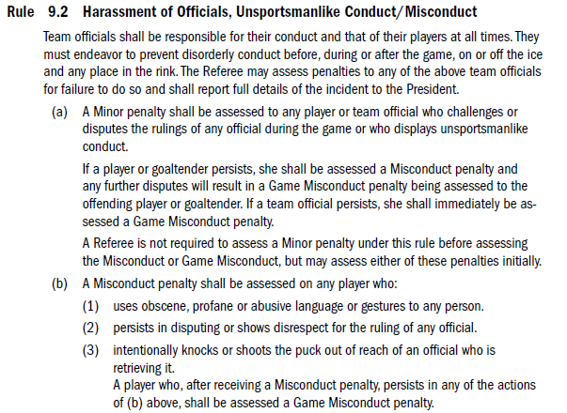
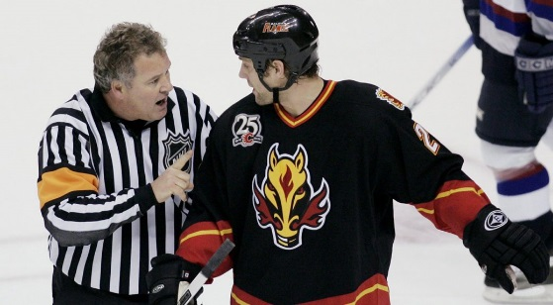
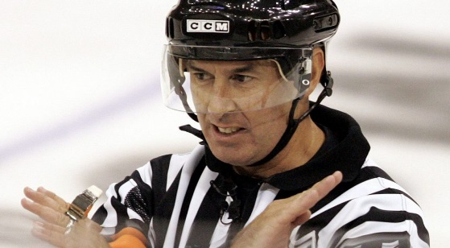
Harassment of Officials, Unsportsmanlike Behaviour – 39 given out last season
Notes:
TTM – Discipline Report - House
93 Infractions entered in TTM (+40)
51 Game misconducts (+14)
14 Misconducts (+8)
6 Match penalties (+2)
20 Gross misconduct (+17)
27 Disrespectful, Abusive and Harassing Behavior/Unsportsmanlike Conduct (+13)
11 Discriminatory Slurs (+9)
184 Games Served
TTM – Discipline Report – RAMS
71 Infractions entered in TTM (+14)
53 Game misconducts (+15)
11 Misconducts (+4)
4 Match penalties (-2)
1 Gross misconduct (-4)
12 Disrespectful, Abusive and Harassing Behavior/Unsportsmanlike Conduct (+1)
1 Discriminatory Slurs (-2)
98 Games Served

Slide 16
Head Coach Team Responsibilities
Equal ice and equal play for all players
  All players should be giving the opportunity to play in all situations
  No shortening the bench
  Make sure to have a team meeting to start the year
    Parents meeting
    Player meeting
  Head Coach should also meet with team staff to set expectations for the year.
Head Coach is 100% responsible for his team, on and off the ice
  This includes their bench staff and parents in the stands.
  Includes the arena area prior to and after a game/practice.
  Don’t forget about the dressing room. We need supervision.

Slide 17
24 Hour Rule
Please use and more importantly have your parents use the 24 Hour Rule
  If you have something to say that could be a point of contention, please wait 24 hours after the event or the game before discussing or sending an email.
Complaint Escalation Process – Please ensure your families follow the escalation process. They will be turned back to the appropriate level if not.
For all issues and concerns please follow the escalation path
  Coach,
  Convenor
  Appropriate Director
    U7/U9 Danny Grills
    U11/U13 Michael Bew
    U15/U18/ U21 James Moser
  Risk and Safety Officer (if safety related) Joe Discher
  President Terry Foley
  Director at Large (Member Ombudsman) Omar Sultan
Please communicate to your parents at your team meeting that they MUST follow the escalation rule

Slide 18
Equipment
Jerseys
All SMHA jerseys must be carried in a garment bag
No SMHA jerseys are to be worn during practice
Jerseys can be worn for fundraising events
Any name or sponsor bars must be sewn onto the jerseys – no glue please.
Coaches and parents will be asked to sign for the condition of their jersey at the start of the season.
A $125 fee will have to be paid to SMHA for any damage to jerseys.
Return jerseys at end of season on hangers, washed and in the Jersey Bags they were issued in along with puck bag, pucks and trainer kit.
Socks
All teams have received red and white socks
Same/matching socks must be worn for all for games (no mixing red and white)
  White with white jerseys, and red with red jerseys.
Name Bars
House League: White on Red. Red on White (Pro2col Uniforms).
Standardized name bars for all house league teams. Red background with white letters for red away jerseys and white background with red for white home jerseys.

Slide 19
SMHA Goalie Development
SMHA Goalie Development Sessions
Development provided by Cobsy’s Goaltending and Consulting
When: Mondays starting October 21, 2024
U9, U11 - 4:30pm – 5:30pm
U13, U15, U18 - 5:30pm – 6:30pm @ JLA
Dates:
  Oct 21, 28
  Nov 04, 11, 18 , 25
  Dec 02, 09, 16
  Jan 06, 13, 20, 27
Where: JLA
Cost: no additional cost to SMHA goalies.
There is goalie gear that can be borrowed/rented if players want to try the goalie position.
If interested, please contact Ben Kirkwood @ equipmentgoalies@stittsvilleminorhockey.com

Slide 20
SMHA Goalie Development
Support from coaches is paramount for the success of our goalies.
U15 + U18 coaches, please watch for an email from Rob Lomas asking for shooters and coach volunteers to assist with the sessions.
Benefit for Shooters
Extra ice touches
Earn Volunteer hours
Benefit for coaches
Participate and learn drills that can be taken back to practice and implemented to continue their goalies development
attend with their goalie to monitor development

Slide 21
Misc. Items…
New House tier naming this season – Switch from A/B/C to Tier 1/2/3. You may not see this naming on the SMHA site, but LCMHL will be using it.
GREEN Arm Band initiative – Green armband denotes that the official is a minor. Harassment penalties are doubled.
No pictures or videos to be taken in the dressing room or posted to Social Media Platforms.
  U7/U9 Parents – just a reminder.
No Father/Mother Son/Daughter games – Must be Hockey Canada Insured Persons ONLY to be on the ice or bench – Parents are also not allowed on the bench during practice or games.
SMHA Players who are on ice helpers- policy is here (applies to helpers under 20 years of age), https://www.hockeyeasternontario.ca/media/mc5daz1y/65-on-ice-helper-policy.pdf
Upon booking tournament(s) please inform your Convenor of the dates. This allows for practice ice to be scheduled accordingly.
  U9 should not have any more than 1 away tournament during the season (3 in total).
Coach Mentor
Mike Roy U7-U18
  Take advantage of their experience.
  Excellent in assisting with running practices.
  Preparing for your season.
  Practice Plans, etc.
  Handling difficult conversations.
  Speak to your Convenor to assist with setting up a meeting.

Slide 22
Misc. Items…continued
Prior to the start of games or practices please make sure no players are sitting on the boards while the Zamboni is on the ice.
There must be a coach with players if players are on the bench prior to an ice time
2 Deep Rule.
Strongly suggest having video person for your games. Provides a way for people who can’t make the games to watch and provides evidence in the case of a suspension or appeal.
Rams Logo
There is only one. There are to be no alterations to the logo of any kind.
Timekeepers
SMHA is uses paid timekeepers and are centrally scheduled the same as the refs.
One timekeeper will do the clock and game sheet for U11 and U13 B and C Two will be provided for U13 A, U15 and U18
In the event no timekeepers are available to do your game, you will be responsible for finding parents to run the clock and complete the game sheet. Please make sure someone on your team is trained to do both duties in the event of an emergency.

Slide 23
Misc. Items…continued
Important Links
Our Governing Body - Hockey Canada https://www.hockeycanada.ca/en-ca/home
Our Branch - Hockey Eastern Ontario (HEO) http://www.hockeyeasternontario.ca/
Our District - District 4 http://www.district4.ca/
Our House League - LCMHL https://lcmhl.ca/
Our Local MHA - SMHA http://stittsvilleminorhockey.com/

Slide 24

Have a great season..!!!

Slide 25
Clinics
This year SMHA will host a Coach 1 clinic on November 16th.
Please ensure that each team has the proper credentials to operate the team through the season. Failure to do may result in suspension.
  http://stittsvilleminorhockey.com/page.php?page_id=66930
  Coach 1: November 16
  Development 1: Various date
  Coach 1: October 14
  Coach 2: October 15
  Coach 2: October 22
For details, please visit our Clinics page under the For Teams tab
The below link is helpful…
http://www.hockeyeasternontario.ca/docs/6.25%20Bench%20and%20OnIce%20Staff%20Certification%20Requirements.pdf

